Slide 1
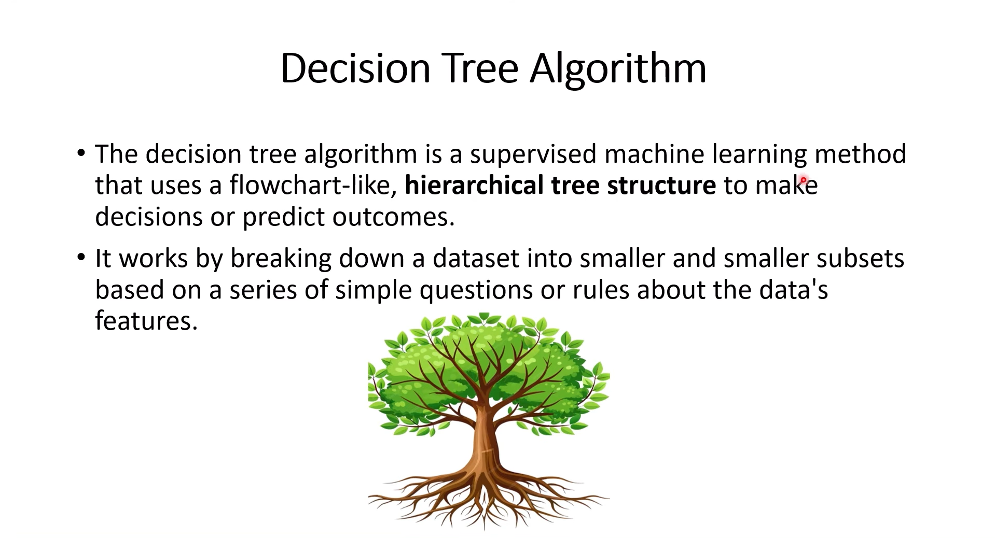

Slide 2
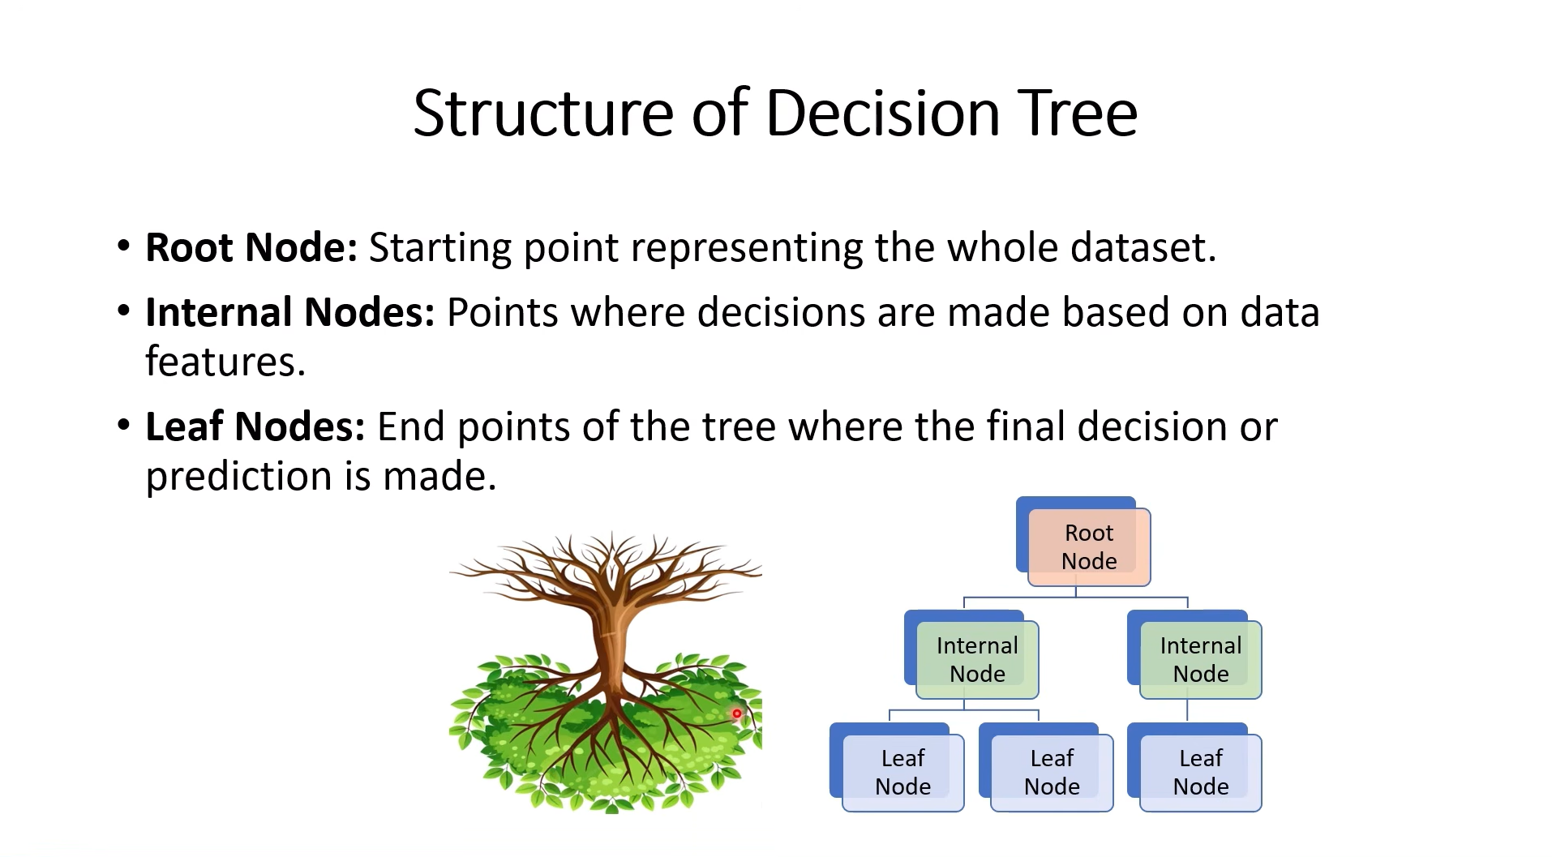

Slide 3
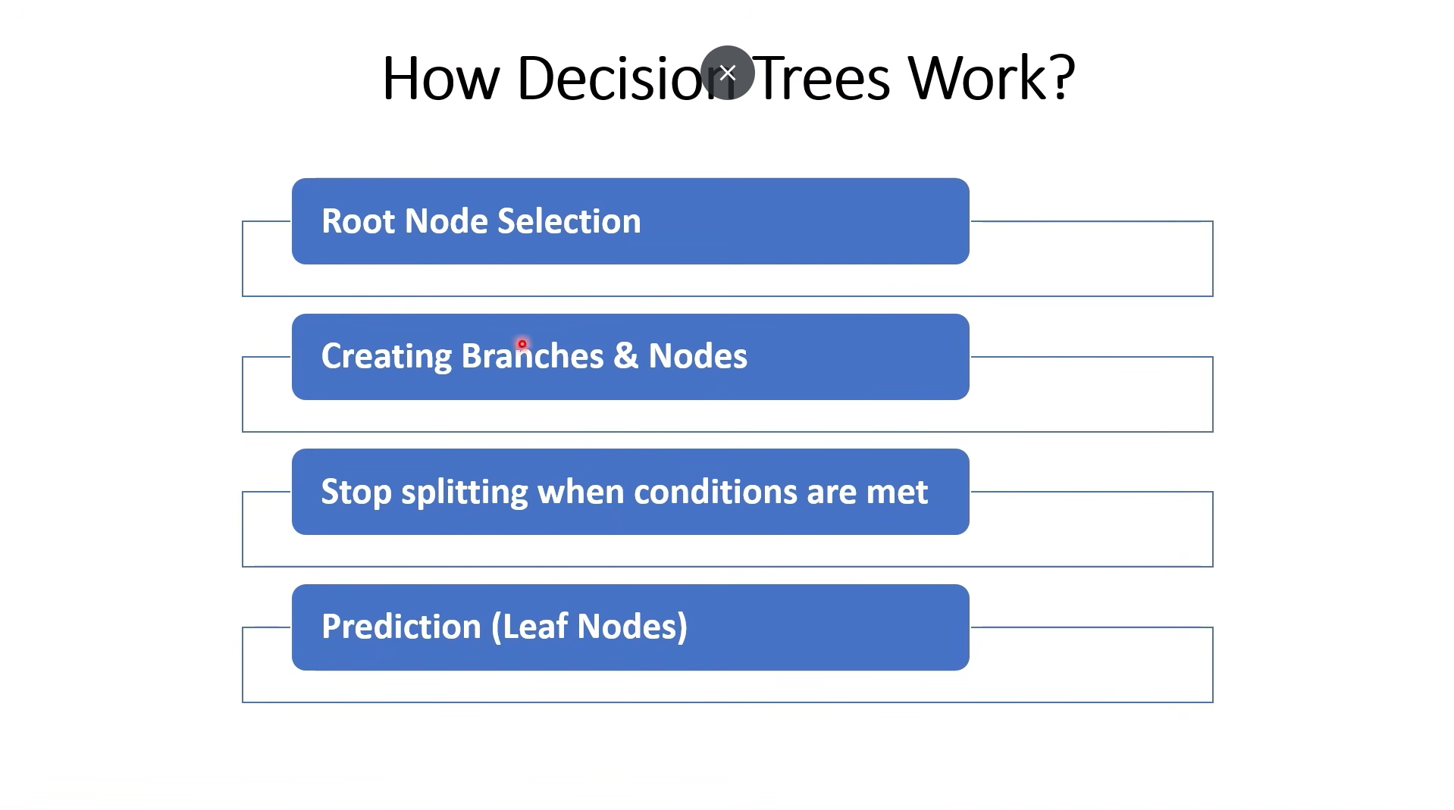

Slide 4
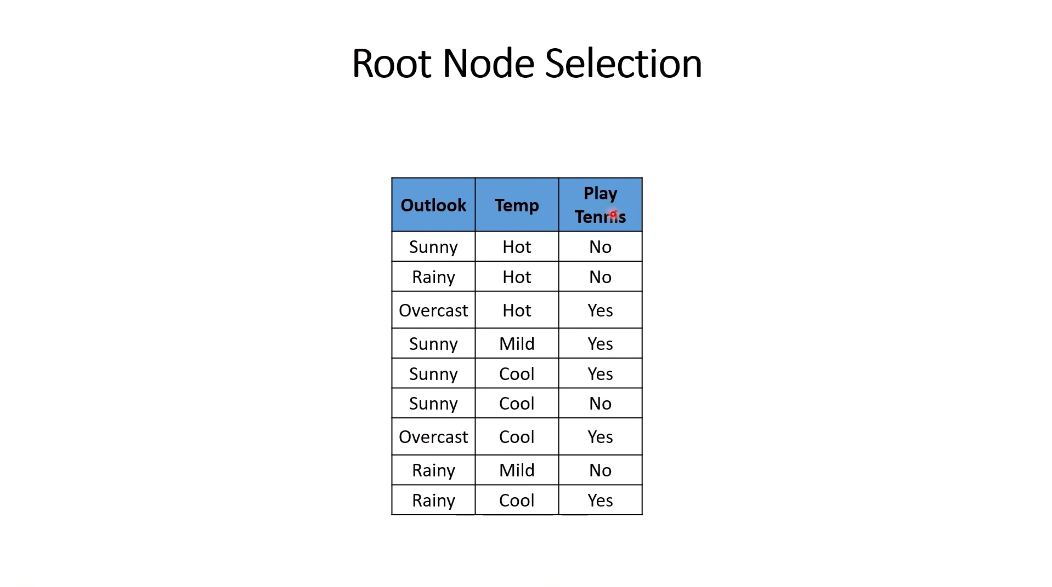

Slide 5
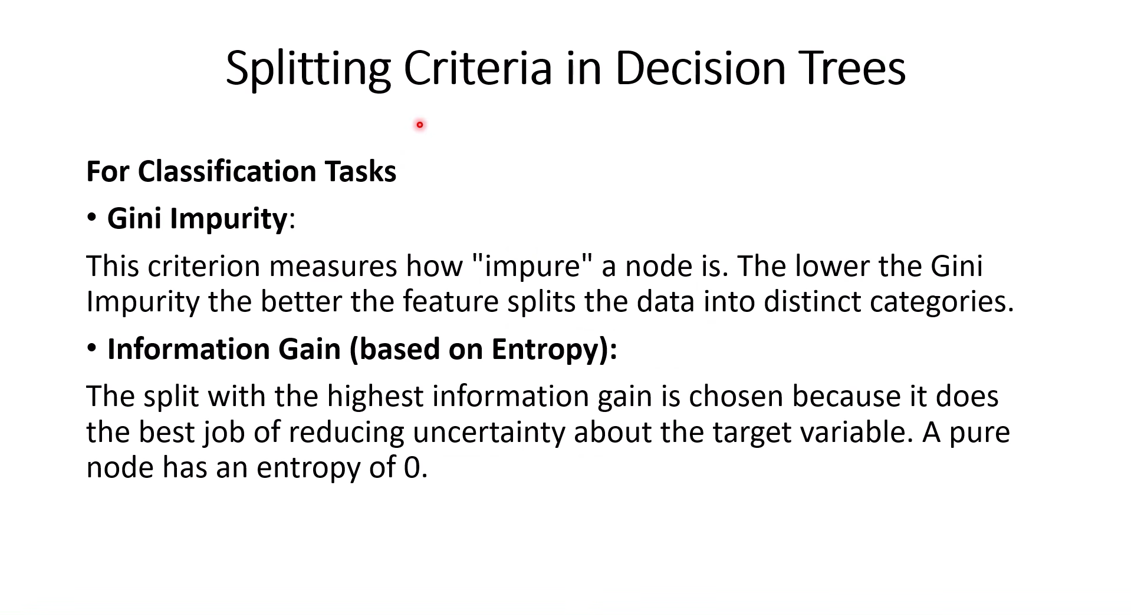

Slide 6
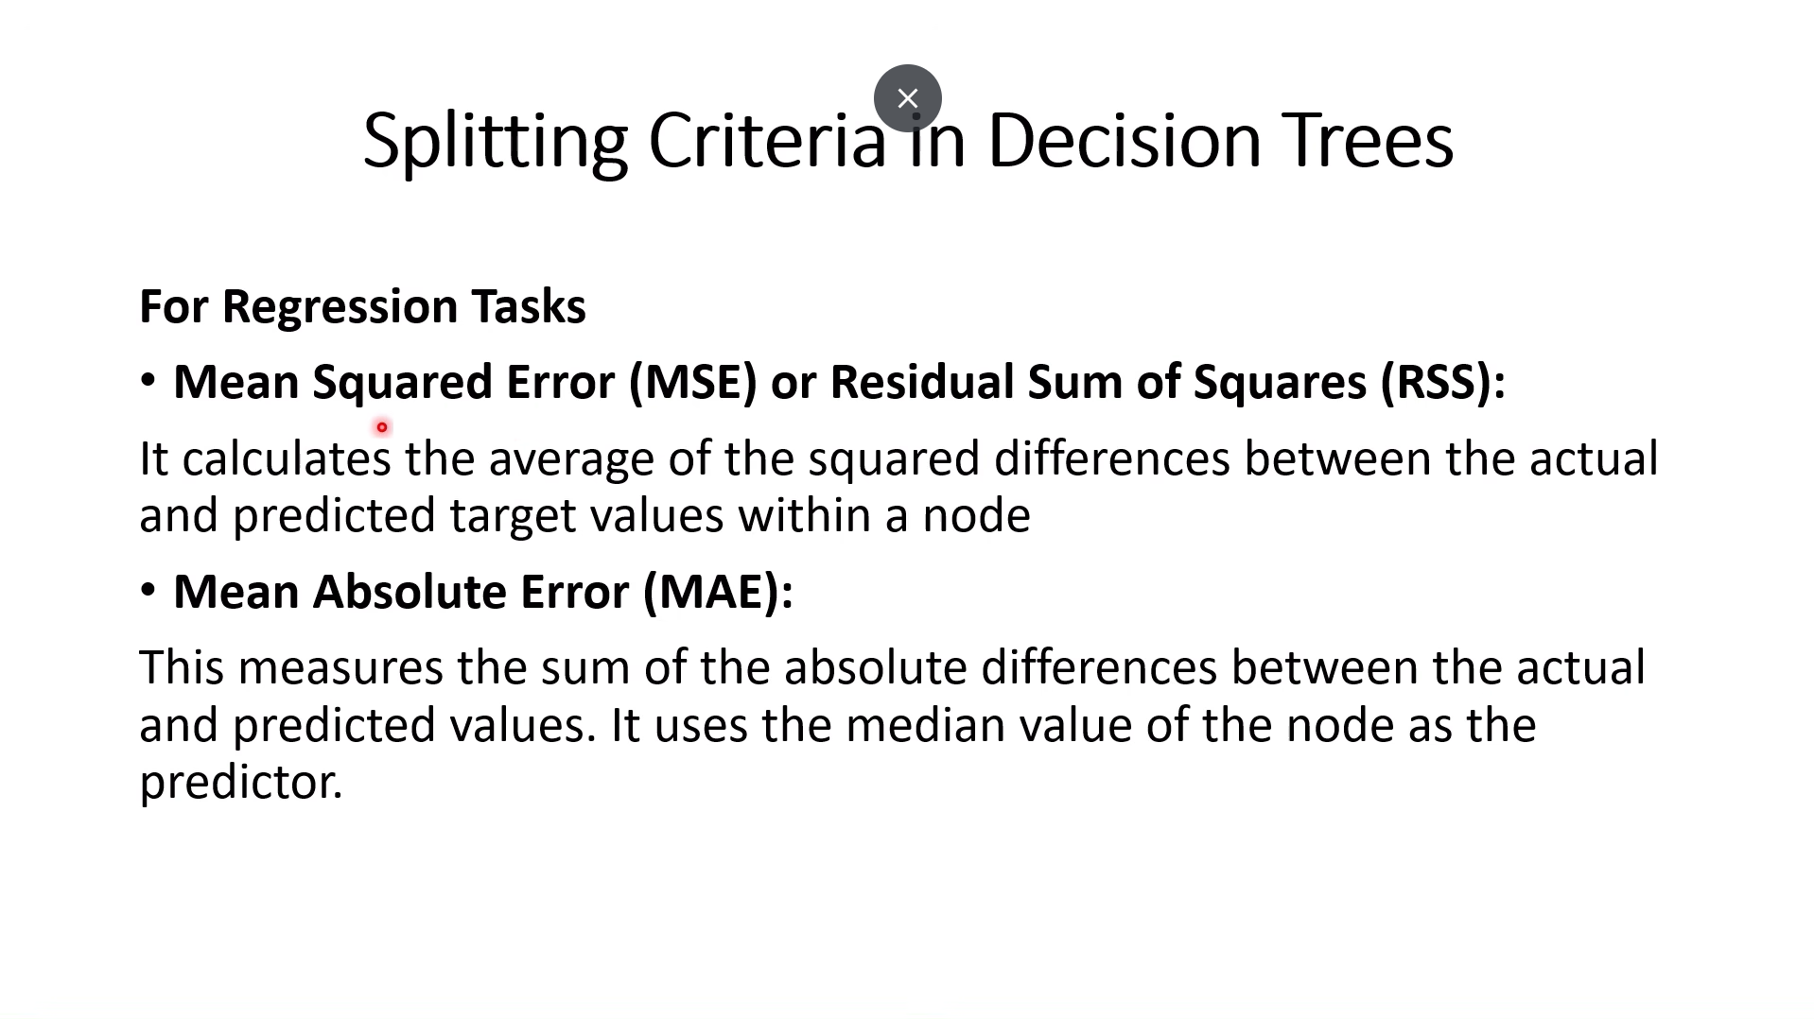

Slide 7
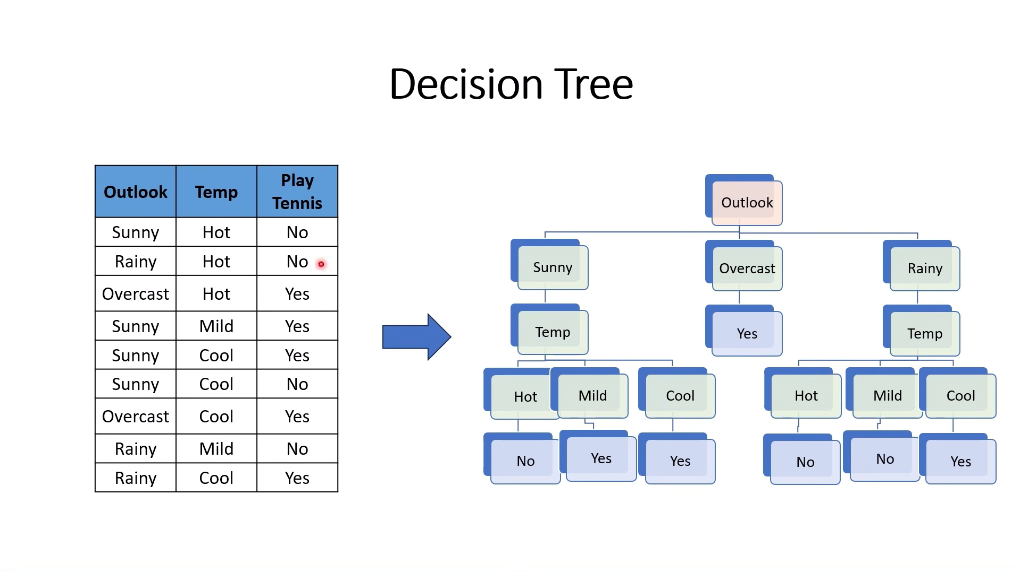

Slide 8
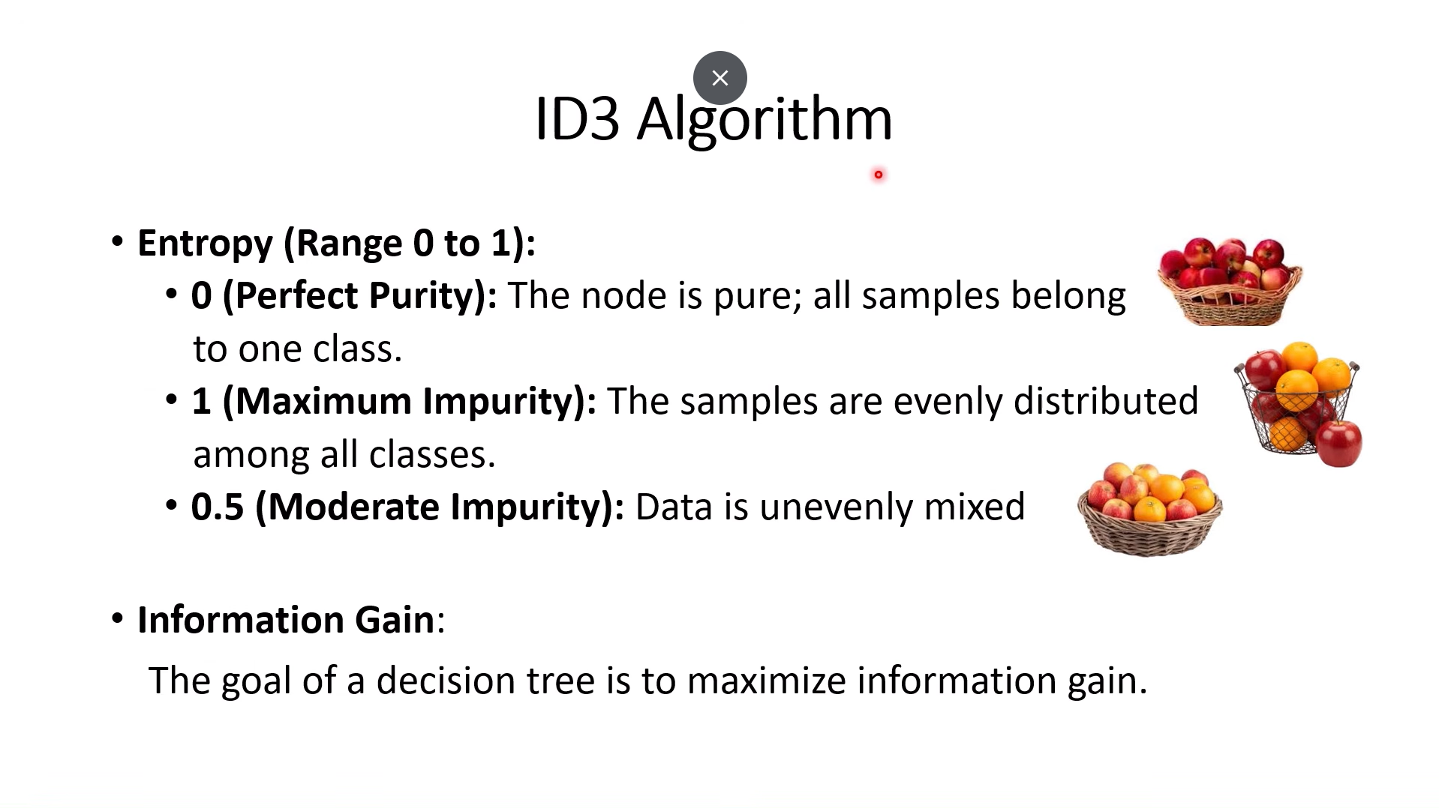

Slide 9
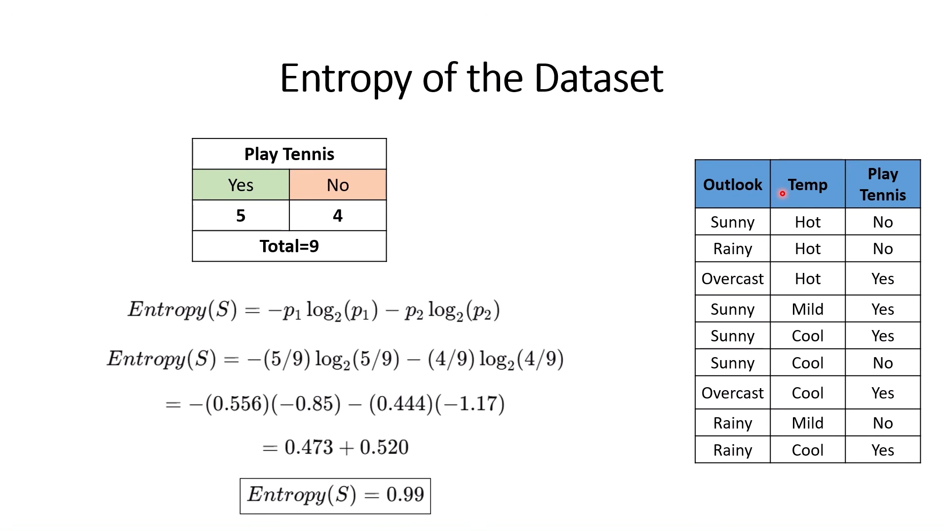

Slide 10
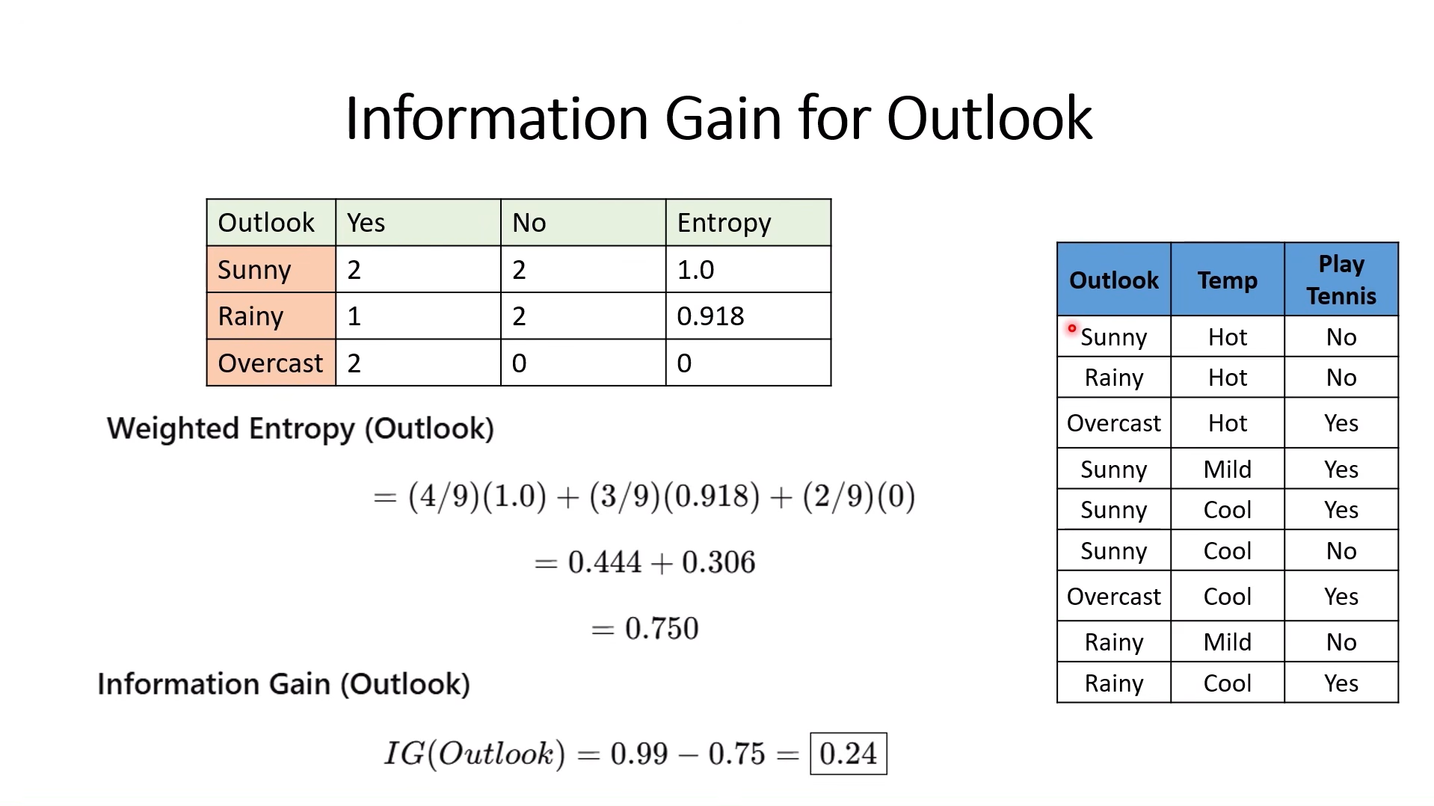

Slide 11
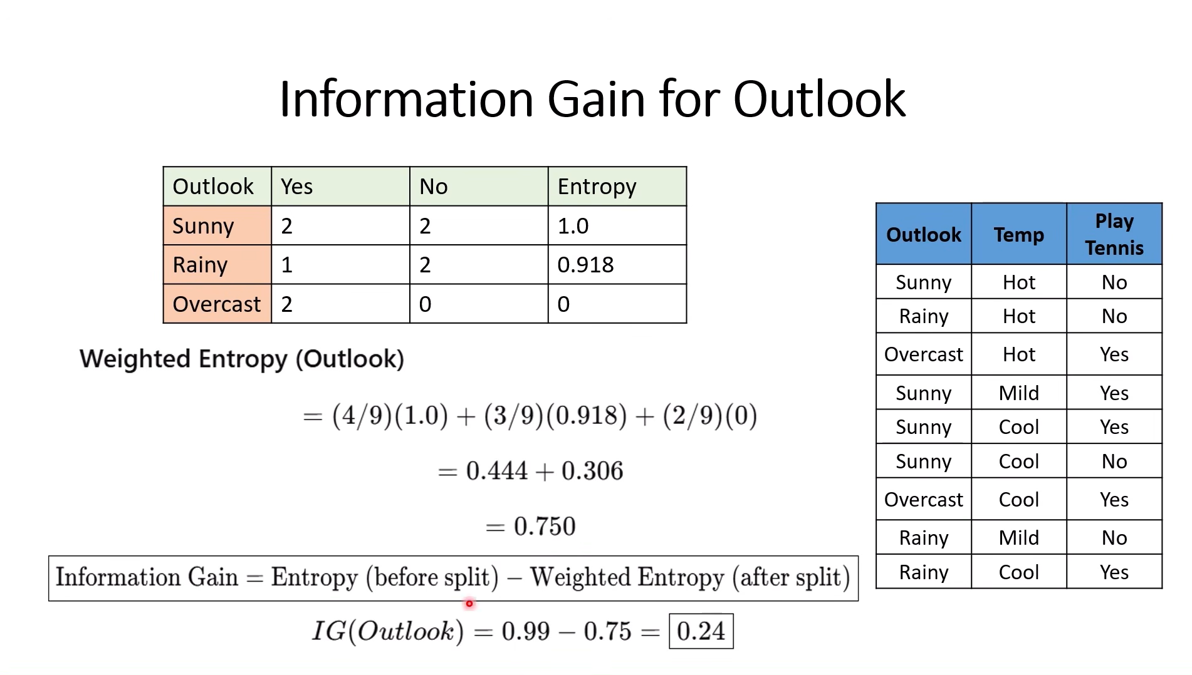

Slide 12
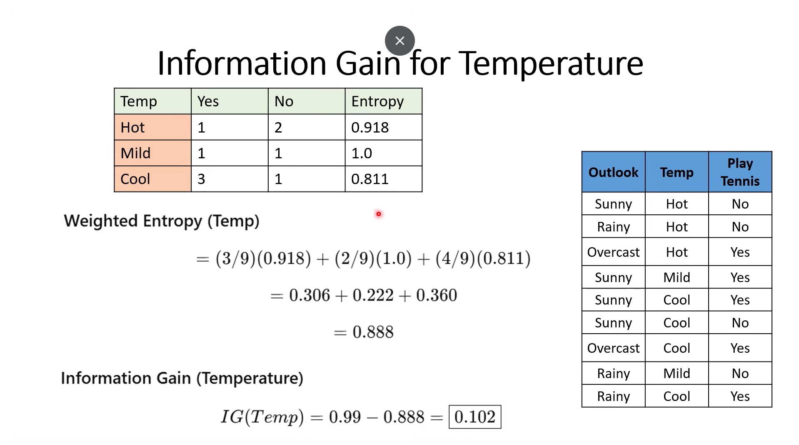

Slide 13
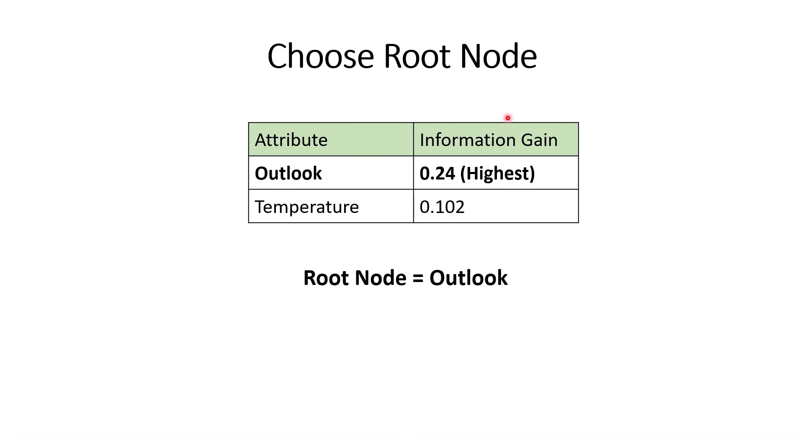

Slide 14
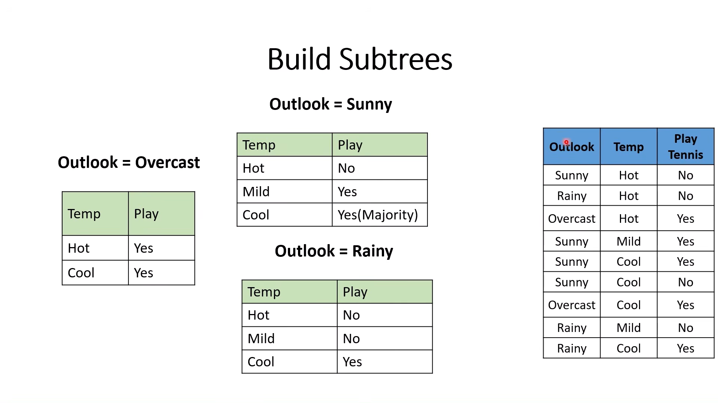

Slide 15
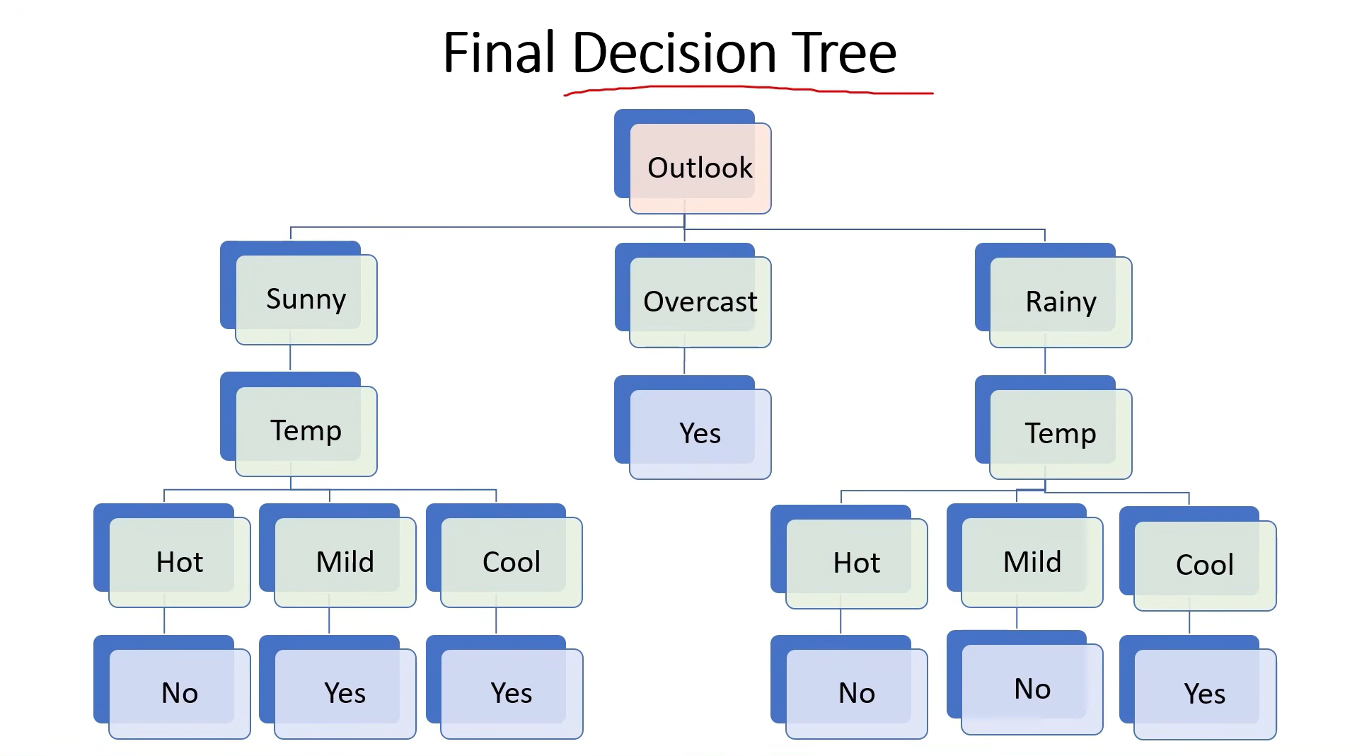

Slide 16
Use the tree to classify: Outlook=Sunny, Temperature=Cool, Humidity=High, Wind=Strong → Predict Play = Yes / No.
Day | Outlook | Temperature | Humidity | Wind | Play
1 | Sunny | Hot | High | Weak | No
2 | Sunny | Hot | High | Strong | No
3 | Overcast | Hot | High | Weak | Yes
4 | Rain | Mild | High | Weak | Yes
5 | Rain | Cool | Normal | Weak | Yes
6 | Rain | Cool | Normal | Strong | No
7 | Overcast | Cool | Normal | Strong | Yes
8 | Sunny | Mild | High | Weak | No
9 | Sunny | Cool | Normal | Weak | Yes
10 | Rain | Mild | Normal | Weak | Yes
11 | Sunny | Mild | Normal | Strong | Yes
12 | Overcast | Mild | High | Strong | Yes
13 | Overcast | Hot | Normal | Weak | Yes
14 | Rain | Mild | High | Strong | No

Slide 17
Decision Tree Classification – Play Tennis
Step-by-step ID3 calculation
Training Data
14 records
Yes = 9, No = 5
Algorithm: ID3
Measure: Entropy + Information Gain
Test Case
Sunny, Cool, High, Strong
Objective: Construct the decision tree and classify the test instance.
Decision Tree – Play Tennis | 1

Slide 18
Step 1 – Entropy of Complete Dataset
Total = 14 Play = Yes: 9 Play = No: 5
Entropy(S) = −p(Yes) log₂ p(Yes) − p(No) log₂ p(No)
= −(9/14) log₂(9/14) − (5/14) log₂(5/14)
= −(0.6429)(−0.6374) − (0.3571)(−1.4854)
Entropy(S) = 0.9403
Decision Tree – Play Tennis | 2

Slide 19
Step 2 – Information Gain for Outlook
Outlook = Sunny, Overcast, Rain
Sunny: 5 records
Yes = 2, No = 3
Entropy = 0.9710
Overcast: 4 records
Yes = 4, No = 0
Entropy = 0
Rain: 5 records
Yes = 3, No = 2
Entropy = 0.9710
Weighted Entropy =
(5/14)(0.9710) + (4/14)(0) + (5/14)(0.9710)
= 0.6935
Gain(Outlook) = 0.9403 − 0.6935 = 0.2468
Decision Tree – Play Tennis | 3

Slide 20
Step 3 – Information Gain for Temperature
Hot: 4 records → Yes = 2, No = 2 → Entropy = 1.0000
Mild: 6 records → Yes = 4, No = 2 → Entropy = 0.9183
Cool: 4 records → Yes = 3, No = 1 → Entropy = 0.8113
Weighted Entropy
= (4/14)(1.0000) + (6/14)(0.9183) + (4/14)(0.8113)
= 0.9111
Gain(Temperature)
= 0.9403 − 0.9111
= 0.0292
Decision Tree – Play Tennis | 4

Slide 21
Step 4 – Information Gain for Humidity
High: 7 records → Yes = 3, No = 4 → Entropy = 0.9852
Normal: 7 records → Yes = 6, No = 1 → Entropy = 0.5917
Weighted Entropy
= (7/14)(0.9852) + (7/14)(0.5917)
= 0.7885
Gain(Humidity)
= 0.9403 − 0.7885
= 0.1518
Decision Tree – Play Tennis | 5

Slide 22
Step 5 – Information Gain for Wind
Weak: 8 records → Yes = 6, No = 2 → Entropy = 0.8113
Strong: 6 records → Yes = 3, No = 3 → Entropy = 1.0000
Weighted Entropy
= (8/14)(0.8113) + (6/14)(1.0000)
= 0.8922
Gain(Wind)
= 0.9403 − 0.8922
= 0.0481
Decision Tree – Play Tennis | 6

Slide 23
Step 6 – Compare Information Gains
Attribute
Gain
Outlook
0.2468
Maximum Information Gain = 0.2468
Therefore ROOT = OUTLOOK
Humidity
0.1518
Wind
0.0481
Temperature
0.0292
Decision Tree – Play Tennis | 7

Slide 24
Step 7 – Calculate Splits for Remaining Branches
SUNNY BRANCH
5 records
Yes = 2, No = 3
RAIN BRANCH
5 records
Yes = 3, No = 2
Best split = Humidity
Best split = Wind
Humidity = High
3 records → Yes=0, No=3
Entropy = 0
→ NO
Humidity = Normal
2 records → Yes=2, No=0
Entropy = 0
→ YES
Weak → YES
Strong → NO
Decision Tree – Play Tennis | 8

Slide 25
Step 8 – Final Decision Tree
OUTLOOK?
Overcast
→ YES
Sunny
Rain
HUMIDITY?
WIND?
High → NO
Normal → YES
Weak → YES
Strong → NO
Decision Tree – Play Tennis | 9

Slide 26
Step 9 – Classification of Given Test Case
Outlook = Sunny
Temperature = Cool
Humidity = High
Wind = Strong
Decision Path
1. Outlook = Sunny
↓
2. Go to Sunny branch
↓
3. Humidity = High
↓
4. Leaf = NO
FINAL PREDICTION
PLAY = NO
Temperature = Cool and Wind = Strong are not evaluated after reaching the leaf.
Decision Tree – Play Tennis | 10

Slide 27
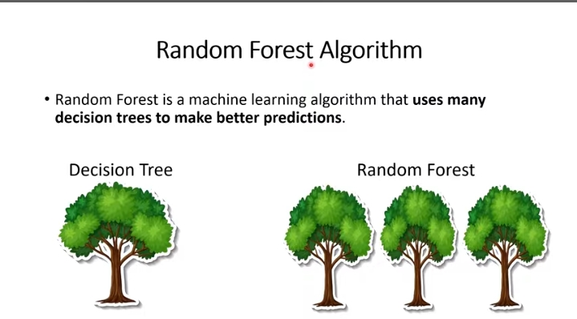

Slide 28
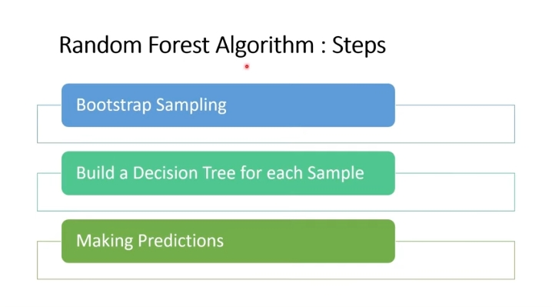

Slide 29
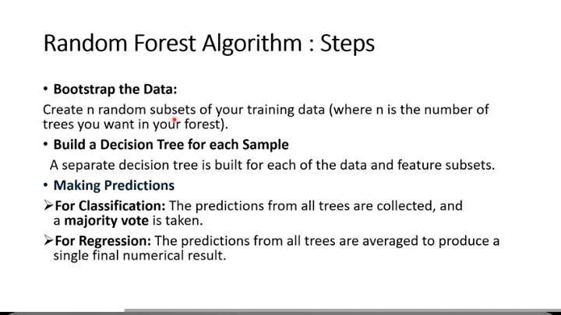

Slide 30
